Slide 1
User’s Guide
Using Open Report Engine
GRS 3.00
© 2010 Four J's Development Tools

Slide 2
Objectives
After this instruction, you will be able to:
Identify the purpose and features of Genero Report Writer (GRW)
Describe the architecture and its components
List the steps for creating a report
Locate and experiment with the Reports demo applications
Find appropriate documentation and help

Slide 3
What is Genero Report Writer?
Streams data from Java JVM for "print-as-you-go" processing
No temporary files or tables required (less memory, more speed)
Gathering of data separate from layout
Based on XML standards
Report layout defined in a separate document using Report Designer
Multiple layouts can be designed for a single data stream
Notes:
Streaming engine:
Data is handled as soon as it’s available
We do NOT load an entire document and handle data afterwards
The whole GRW architecture is based on streaming
Advantages of this solution:
Optimization of the memory
Each report page is generated as soon as there’s enough data
You can create longs reports without any (performance) problem
Gathering data: Data Engine:
Purpose = gather data to be used in the report
Done in the BDL program
Data push technology:
The report receives data from the application
No need to go ahead and seek for the data
Powerful data language
Data flow is generated in the Java program
Java language will be useful for that
There are 3 important points to focus on:
Data is centralized
Data is recovered by different methods in Java
We are going to gather all the data
Complex data flow definition:
Data flow is directly extracted from the database
Advantages of that solution (in comparison with other tools using SQL to extract data):
No need for temporary tables :
Java is powerful to recover and centralize data
Also avoids useless copies of databases (or part of databases)
Finally:
When using another tool → There’s often a “delay” in the data (not up to date)
With our method: Data used is real data, up to date. No synchronization problems
Technologies are based on standards:
Report file uses XML format, data transfer is done in XML format
Report document = XML document
Created in a designer
Extension 4rp
This format will be documented to be able to generate easily a report document (without using the designer)

Slide 4
Features
Enterprise Reports
Scalability
Streaming architecture
Drag-and-drop GUI report design
Dynamic layout
Maintainability
Notes:
Sacalability:
Ability of a system to handle a growing amount of work in a capable manner or its ability to be enlarged to accommodate that growth
Ex: capability of a system to increase its total output under an increased load when resources (typically hardware) are added
Maintainability:
ease with which a product can be maintained in order to:
isolate defects or their cause,
correct defects or their cause,
repair or replace faulty or worn-out components without having to replace still-working parts,
prevent unexpected breakdowns,
maximize a product's useful life,
maximize efficiency, reliability, and safety,
meet new requirements,
make future maintenance easier, or cope with a changed environment

Slide 5
Architecture
XML Standards
DataStream is XML
Report Design file (.4rp) is XML
SVG output (.svg) is XML
Gathering of data is separate from layout
Same data can be used to print many different reports in different formats
End to end streaming, print as you go
Note: Internals of certain formats (PDF) do not support end to end streaming
Notes:
Technologies are based on standards:
Report file uses XML format, data transfer is done in XML format
Report document = XML document
Created in a designer
Extension 4rp
This format will be documented to be able to generate easily a report document (without using the designer)
Gathering data: Data Engine:
Purpose = gather data to be used in the report
Done in the Java program
Data push technology:
The report receives data from the application
No need to go ahead and seek for the data
Powerful data language
Data flow is generated in the Java program
4GL language will be useful for that
There are 3 important points to focus on:
Data is centralized
Data is recovered by different methods in Java
We are going to gather all the data
Complex data flow definition:
Data flow is directly extracted from the database
Advantages of that solution (in comparison with other tools using SQL to extract data):
No need for temporary tables :
Java is powerful to recover and centralize data
Also avoids useless copies of databases (or part of databases)
Finally:
When using another tool → There’s often a “delay” in the data (not up to date)
With our method: Data used is real data, up to date. No synchronization problems
Streaming engine:
Streaming: This means we can show page 1 (or print page 1) whilst we are figuring out page 2
So don’t have to wait for all 1000 pages to be generated before you start viewing
Data is handled as soon as it’s available
We do NOT load an entire document and handle data afterwards
The whole GRW architecture is based on streaming
Advantages of this solution:
Optimization of the memory
Each report page is generated as soon as there’s enough data
You can create longs reports without any (performance) problem
Limitations of streaming
Print page numbers in format ‘Page n of m’
Not in all output formats (not in PDF for example)

Slide 6
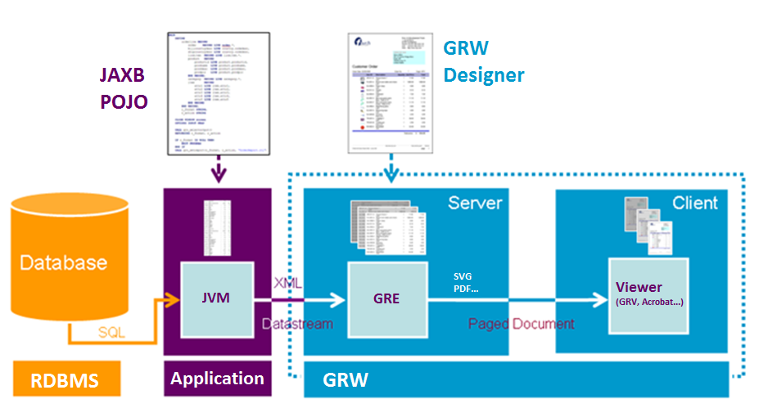
Architecture
Notes:
Overall picture of the GRW architecture
Emphasise:
Any database
Any Java
GRE could be on separate server from JDK
GRD, GRE, Viewer separate components
Don’t need JVM to generate reports, can pass XML datastream
The components that make up the Genero Report Writer
Data Source:
The data source could be a database or an XML file.
In this training: we will connect to and use a database as the source of our data
JVM:
Executes the Java application that extracts the data from the data source and streams it to the report engine
Genero Report Designer:
Provides you with the GUI to create and format a report in a Report Design Document (.4rp file).
When creating a report, you specify a data view that defines the structure of the record to be streamed by the report engine.
The Genero Report Designer is part of Genero Report Studio
Report Engine:
Takes the data stream from the JVM and formats the resulting report as defined in the Report Design Document
Viewer:
If you select to view the report using SVG, it opens in the Genero Report Viewer
Is part of the Genero Desktop Client.
Alternatively, you could have sent your report directly to a printer, or saved it as any supported output format.

Slide 7
Architecture
Annotated Java POJO classes to produce XML DataStream
Uses JAXB to produce XML data stream
Notes:
Java has business logic i.e.
Security
functions e.g. get_price(), tax calculations
don’t need to recreate that functionality inside an SQL stored procedure

Slide 8
Architecture
Genero Report Designer (GRD) design a report
Near WYSIWYG editor to design the appearance of a report
Notes:
The layout of the report is designed with a graphical designer: GRD
Included in Genero Report Studio, but also available standalone
Creates report definition files (XML files with extension 4rp)
Provides a data representation
Enables document edition
Using containers and objects provided
Define properties for the elements
Near WYSIWYG (seen later)
Don’t have to be a Java developer to design report
Still need:
some understanding of grouping, data, datatypes
some logic sense
Can be compared to EXCEL:
No difference to editing Excel formulas e.g. concatentate
If you can use Excel to get data from a database and use Excel formulas you’ll be familiar with concepts
Data can be reached through a data schema file (explained later in this PPT):
Also:
Specific functions (APIs) to configure the report

Slide 9
Architecture
Genero Report Engine uses these two inputs to produce a formatted report
XML DataStream + Report Design = Formatted Output
The Layouter does the Layouting
Calculates where to position objects, and how to render them
GRE typically runs on a server, similar to application or database server
Notes:
The key calculation: XML datastream + Report Design = Formatted Output
GRE combines:
XML data flow, sent by the JVM
Report definition file, created in the Designer
GRE creates the report pages
Same data stream plus different designs can be used to create different output: PDF, SVG, Image, HTML, XLS, XSLX, RTF, OORTF, Printer
Allows division of labor:
Java coder can create the data stream
BA (business analyst), or even the end-user can create their own report
The presentation of the report can be changed independently of data:
Final customers can personalize their reports:
Send the report definition file (.4rp)
Send them data schema file (we’ll see this)
Install the designer
Do modifications

Slide 10
Architecture
Viewing occurs on end-users client
Genero Report Viewer or Web Viewer to view SVG reports
PDF viewer for PDF reports
Any image viewer for Image reports.
Any browser for HTML reports
MS-Excel for XLS/XLSX reports
MS-Word/Open Office for RTF/OORTF reports
Notes:
Report documents can be saved on disk or shown in a viewer
For SVG:
Specific viewer included in the GDC: Genero Report Viewer
For other output formats:
Viewer depends on the format (AcrobatReader for PDF, Excel for XLS, browser for HTML…)
No preview for Image
Can only be saved on disk
As images, these can be embedded directly into a Genero application

Slide 11
Architecture
xsd file
Report Data Definition (XSD file)
When designing reports, need to inform the report designer about what information will be available in the report
Notes:
The report designer needs to know what is in the report
Hence Data Schema file and a XML datastream needs to be prepared before designer can start a report
The data schema file:
.xsd file
XSD file: generated through specific ‘schemagen’ command or another (external) process
File loaded in the designer
It doesn’t contain any value, it contains only infos about data (type, size, etc.)
Doesn’t have to be 100% correct, you can add extra fields later

Slide 12
File Extensions
java
Java source file
xsd
Definition of data and structure of REPORT statements in .java source. Used by Genero Report Designer in design of reports
xml
DataStream produced by the Java application.
Allows you to repeatedly test reports without selecting data from the database multiple times
4rp
Design of a report
svg, pdf, Image (jpg, png, bmp and others), xls, xslx, html, rtf, oortf, Printer
Different output formats of a report
Notes:
These file extensions you’ll hear me refer to
If using source control: 4rp needs to be in source control like .java and other resource files

Slide 13
Report Process
Determine report requirements
Organize the project workspace
Create the Java report application
Written from hand in Java
Can use BAM to generate a data source
Generate the .xsd file
Use JAXB’s ‘schemagen’
Provides the Data View for a report
Design report document using Genero Report Designer
Run the report application
View the report in any viewer (depending on the output format)
Notes:
This slide identifies the basic steps for creating a report, in the order that they need to be taken.
Determine your report requirements.
What data do you need to extract?
Are you going to need to group or summarize by specific data values?
You need to know this information prior to creating your Java application.
Start a new project workspace
Define the project nodes (applications, libraries, virtual folders) to organize your files
specifying the dependencies
Other options (passing parameters, personalized build rules…)
Create your Java application
You can write directly the code
You can use the BAM
You use ‘schemagen’ to create the .xsd file.
From the command line or in the build rules of GRS
This file details the record (data) that will be streamed to the GRE when the report is run.
Design your report using Genero Report Designer
When you create a report definition file (.4rp), you select an .xsd file (and maybe a REPORT) to provide the Data View for the report
Run the report application, specifying the report design document (.4rp) to use when outputting the report.
If you specify SVG as the output (default), the report opens in Genero Report Viewer for your perusal.
We will cover each of these steps in detail in future modules of this training.

Slide 14
Processing pipe

Slide 15
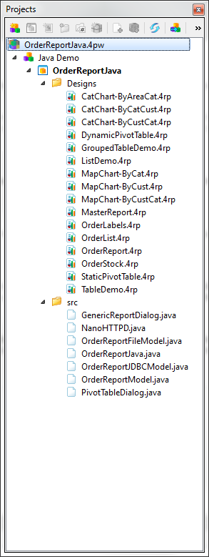
Reports Demo
OrderReportJava.4pw
Project contains:
Java application files (.java sources)
Report definition documents
Order Report - a customer order
Order Labels - pages of mailing labels for customers
Order Stock - stock information including a bar code
List Demo/Order List- reports in list format
Table demo - report as a table
A variety of Map Charts and Category Charts
Static and dynamic Pivot Table
Notes:
The default GRW demo project workspace: OrderReportJava.4pw
Located in:
Windows: C:\Users\<user>\Documents\My Genero Report Studio Files\samples\Reports\OrderReportJava
Linux: /home/<user>/Genero Report Studio Files/samples/Reports/OrderReportJava
If working from a fresh and complete installation of Genero Report Studio, then the Reports project workspace is listed in the Recent Projects listing.
These files provide a real-time look into the various files that make up the report application and the report design documents.
They provide a great reference for persons new to Genero Report Writer.

Slide 16
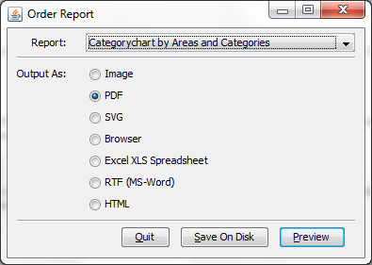
Understanding the sample
In $SAMPLESDIR (Windows: C:\Users\rw\Documents\My Genero Report Studio Files\samples\Reports\OrderReportJava)
Open OrderReportJava.4pw
1 Java Swing Application: OrderReportJava
Demonstrates most of the available Genero Report Writer features
OrderReport.java
Main Java source defining a Swing dialog
Allow users to select different designs and output options
private static boolean runFromFile = false
Runs report from a .unl file, set to false if you want to run from database
void createAndShowUI()
Shows a Swing user interface
Allows user to select report to produce
Output format e.g. Image, PDF, SVG
Action (e.g. preview, save) chosen in menu
Options selected used in lines If(“XLS”.equals(output)) renderer=new ExcelRenderer();
report.runFromJAXBObject(data);
If(“Preview”.equals(action) && Desktop.isDesktopSupported())
Desktop.getDesktop().open(new File(outputFileName));
Notes:
runFromFile, Boolean
When running from file, using file ‘OrderReport.unl’
The INPUT allows user to select options which are then used in 4gl code to configure the report
This is a kind of configuration window which can be reused in different programs

Slide 17
Understanding the sample
NanoHTTPD.java
Handles HTTP requests for the Web Report Viewer
OrderReportModel.java
Abstract class describing the report data model
OrderReportJDBCModel.java & OrderReportFileModel.java
Implementation of the report model using JDBC (MySql officestore)
Implementation of the report model using a file
GenericReportDialog.java
Swing dialog that allows users to select fields for the generic report
PivotTableDialog.java
Swing dialog that allows users to select measures and dimensions for the dynamic pivot table example
Notes:
NanoHTTPD.java
"Mini" Web Server
OrderReportJDBCModel.java & OrderReportFileModel.java
Implementation of the report model using JDBC (MySql officestore)
Implementation of the report model using the file 'OrderReport.unl'

Slide 18
Understanding the sample
We will learn the meaning of these key lines later today ...
LayoutedPagesConsumer renderer;
report=new FourRpProcessor(fourRpfilepath, layout);
data=new OrderReportJDBCModel(controlBlock)
report.runFromJAXBObject(data);
data = new OrderReportJDBCModel(controlBlock);

Slide 19
Understanding the sample
Reports include (1)
OrderReport.4rp
Illustrates use of the section property, note the different page header/footer on each page..
OrdersLabels.4rp
Illustrate the labels functionality enabling you to print multiple labels on a single page
OrderList.4rp
An example of a simple list produced from the List Template.
OrderStock.4rp
Illustrates barcodes
Can be used to illustrate attachment and positioning rules
How to design a report onto pre-printed paper using a background image

Slide 20
Understanding the sample
Reports include (2)
TableDemo.4rp
An example showing a simple usage of TABLE
GroupedTableDemo.4rp
TABLE with several header and body rows
ListDemo.4rp
Has two examples of RTL expressions. The changing color of the font and the hands-up/hands-down image are both RTL expressions to change the color and orientation at run-time based on the field value.

Slide 21
Understanding the sample
Reports include (3)
CatChart-By*.4rp
An example showing a “Category” Chart (grouped by two fields). More than one example to show how different charts can be produced from the same data.
MapChart-By*.4rp
An example showing a “Map” Chart (grouped by one field). More than one example to show how different charts can be produced from the same data.
StaticPivotTable.4rp
A table of customer data, grouped by customers and orders.
DynamicPivotTable.4rp
Generates a table of user-selected measures, grouped by user-selected dimensions

Slide 22
Online Help Documentation
Accessing online help
Help button in toolbar
F1 key
Start >> All Programs >> Genero Report Studio >> Genero Report Studio Help
Notes:
The Genero Report Writer manual is provided as part of the Genero Report Studio documentation
As indicated in the slide above, you have a variety of methods for accessing the online documentation.
F1: Contextual help: the documentation opens on the affected item

